Slide 1
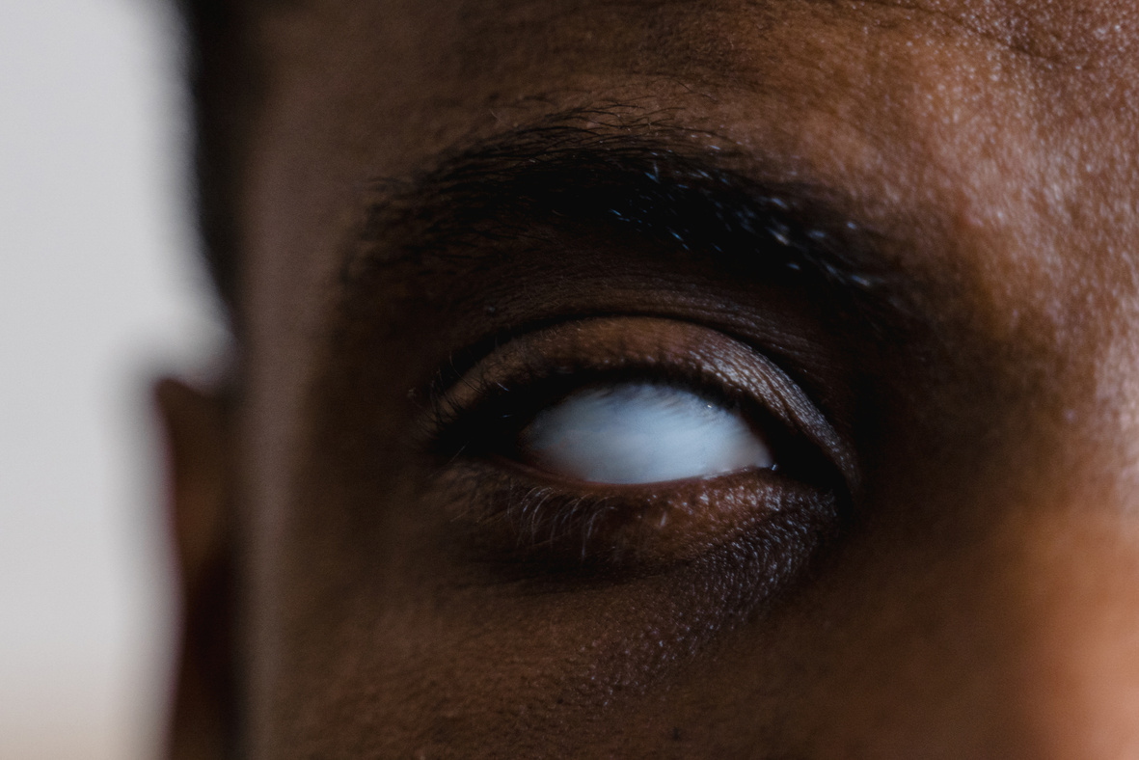
SMART VISION TO ASSIT BLIND PEOPLES
helping visually impaired individuals to detect objects in their surrondings

Slide 2

GLOBAL IMPACT
285M visually impaired, 39M blind globally.
THE CHALLENGE
Mobility, obstacle avoidance, reading, recognition.
Daily Obstacles
Navigating the World
Canes, dogs, wearables have limited functionality
Tech Limitations

Slide 3


SMART GLASSES: THE OBJECT DETECTION SOLUTION

Slide 4
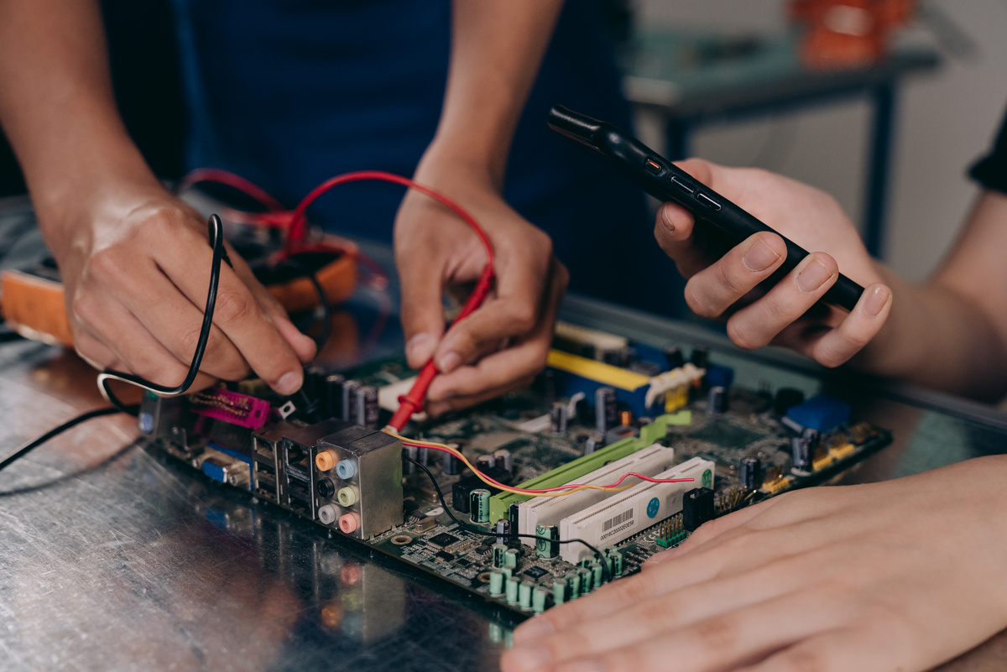
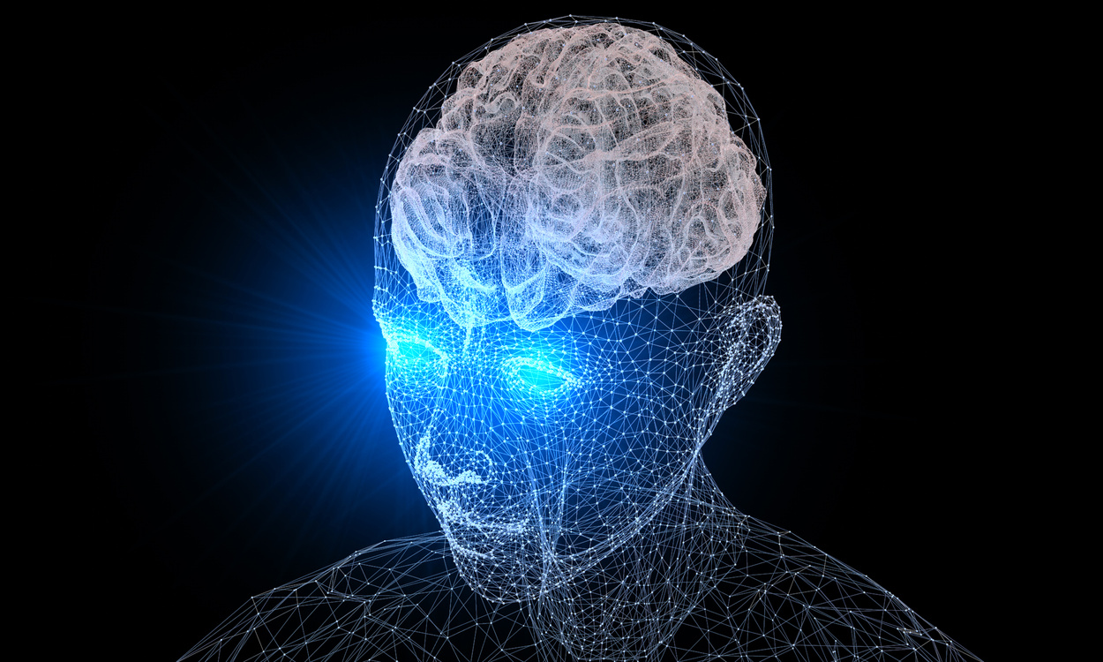
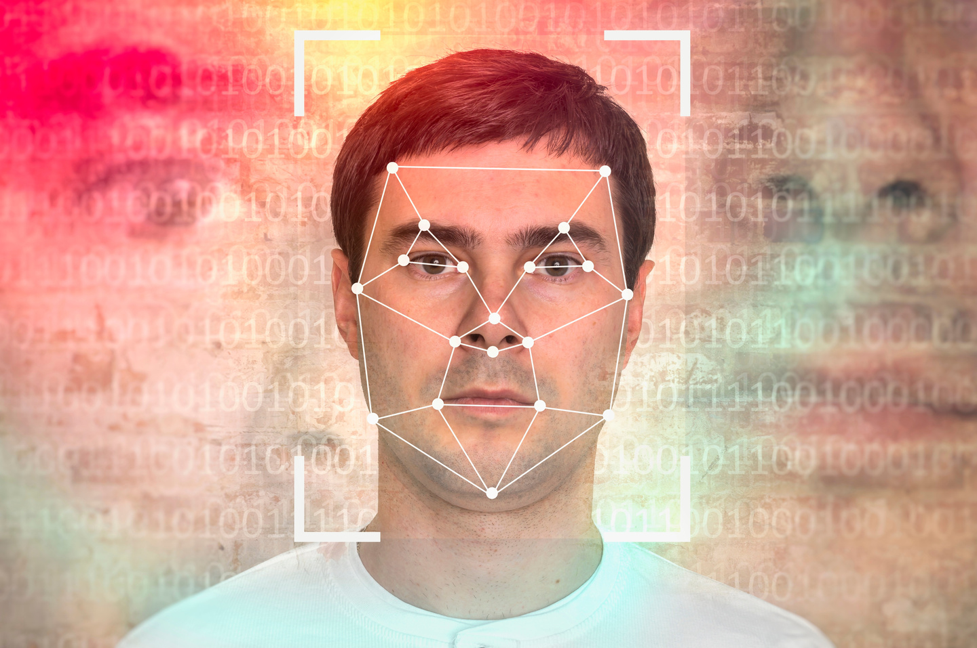
Cameras, processors, audio output
Computer vision for image analysis.
Object ID, text reading, facial recognition

Slide 5


AI and Computer Vision: The Core
Deep Learning. - CNNs for object recognition.
Real-Time - Edge computing for low latency.
Detection Models - YOLO V3, SSD, Faster R-CNN.

Slide 6


Impact: Empowering Independence
Enhanced Mobility
Improved Safety

Slide 7


DEVELOPMENT: COMPONENTS & CHALLENGES
1
Core Components
-Camera, processor, battery, headphones
2
Software
-Object detection, text-tospeech, UI.
3
Key Challenges
-Power, speed, accuracy, user comfort

Slide 8
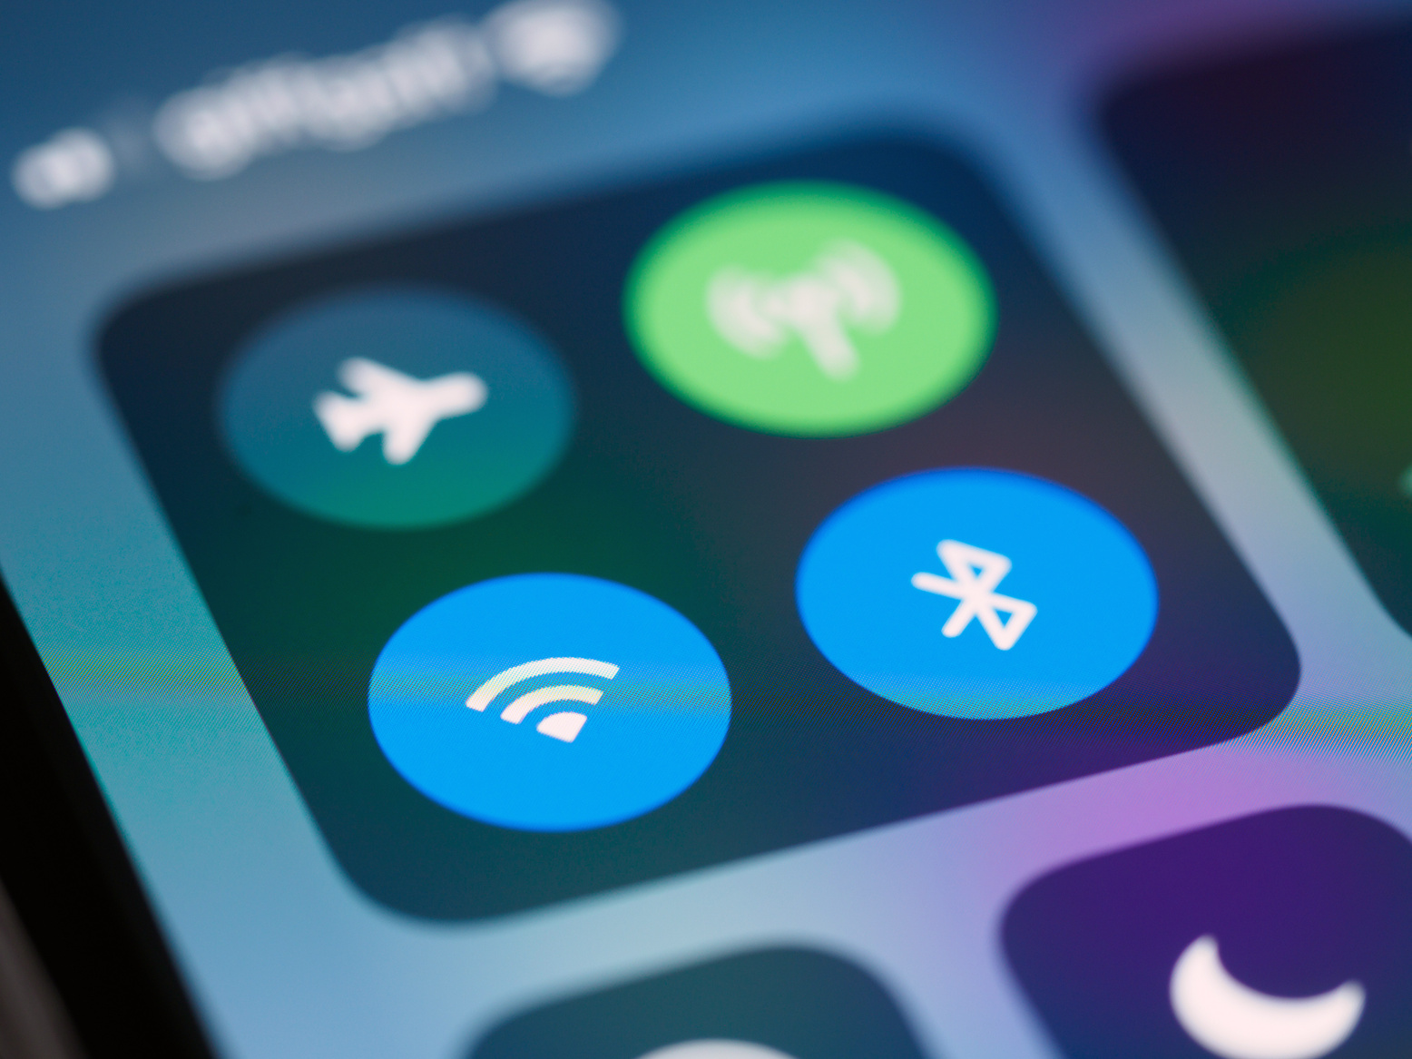
EXCITING FEATURES
AI Voice Assistant
Weather Updates
Book Reading & Storytelling
Hands-Free Voice Command

